Slide 1
R + TensorFlow
Zilong Zhao, Data Scientist
Zilong.Zhao@yahoo.de
Mainz, 6. June 2017

Slide 3
R (programming language)
What is R?
open source, GNU GPL v2
statistical computing, data analysis, data modelling
Stable release: 3.4.0 (You Stupid Darkness)
Example code:
> x <- c(0, -1, 1, -2, 2)
> y <- x^2
> y
[1] 0 1 1 4 4
> mean(y)
[1] 2

Slide 5

What is TensorFlow?

Slide 6
A software library for machine intelligence from Google
About TensorFlow
Developed by the Google brain team, open source since Nov. 9th, 2015
Scalable for cross-platform such as CPUs or GPUs in servers, desktops and also capable on mobile devices
Currently used for both research and production
Stable release: 1.1
native for Python, now available for Java, Go, C and R
Simple installation for Python:
$ pip install tensorflow
$ pip install tensorflow-gpu

Slide 7
How to install TensorFlow with R API?
Installation (Mac OS X)
Requirements:
Anaconda Python (https://www.continuum.io/downloads)
pip install -–upgrade https://storage.googleapis.com/tensorflow/mac/cpu/tensorflow-1.1.0-py3-none-any.whl
add following lines in BASH
R for Mac OS X
# added by Anaconda3 4.3.1 installer
export PATH="/Users/Zilong/anaconda3/bin:$PATH"
devtools::install_github(„rstudio/tensorflow“)
library(tensorflow)
install_tensorflow()

Slide 8
That’s it!

Slide 9
Hello, TensorFlow!
TensorFlow in R
Python (IPython console)
R
In [1]: import tensorflow as tf
In [2]: sess = tf.Session()
In [3]: hello = tf.constant("Hello, TensorFlow!")
In [5]: sess.run(hello)
Out[5]: b'Hello, TensorFlow!'
> library("tensorflow")
> sess = tf$Session()
> hello <- tf$constant("Hello, TensorFlow!")
> sess$run(hello)
b'Hello, TensorFlow!'

Slide 10
Iris flower data
Demo
Ronald Fisher, 17 February 1890 – 29 July 1962,
british statistician and biologist.

Slide 11
Dimension (150, 4+1)
The Iris example
Four features: sepal length, sepal width, petal length, petal width
Classification problem: 3 Categories of Iris species
150 rows
Iris setosa
Iris versicolor
Model & Results
Fully-connected NN with two hidden layers (3, 3)
Accuracy of prediction: 100% on 20% test data set
Iris virginica

Slide 12
Coding with TensorFlow too complicated?
Summary & Outlook
Keras, high-level API for Python. Built on top of TensorFlow and Theano
R Interface to the Keras Deep Learning Library (https://cran.r-project.org/web/packages/kerasR/vignettes/introduction.html)
TensorFlow on CPU too slow?
Have a try with NVIDIA GPU
TensorFlowOnSpark (https://github.com/yahoo/TensorFlowOnSpark)
TensorFlow RESEARCH CLOUD with Google’s Cloud TPUs (https://www.tensorflow.org/tfrc/)

Slide 13
Credits
Wikipedia
GitHub
YouTube
CRAN
Google

Slide 14
Ads time

Slide 15


Slide 16
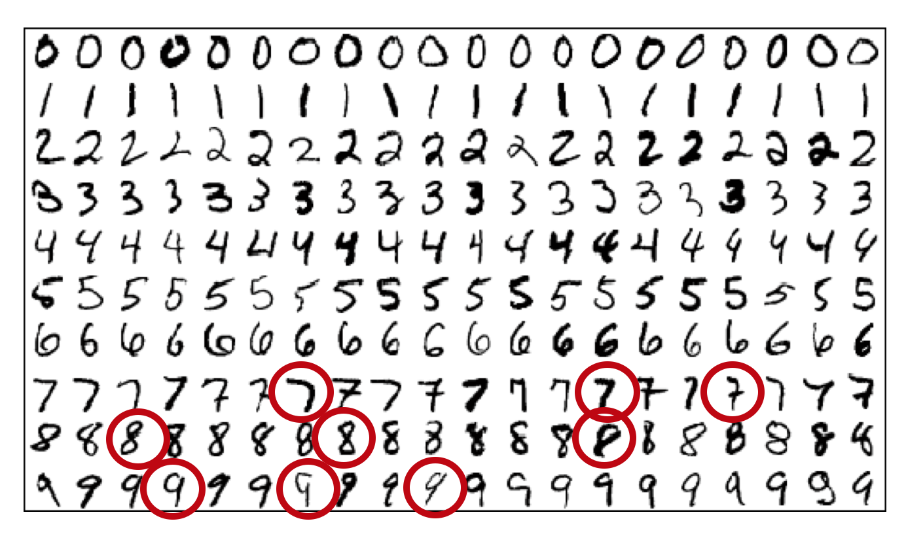
MNIST handwritten database, by Yann LeCun

Slide 17
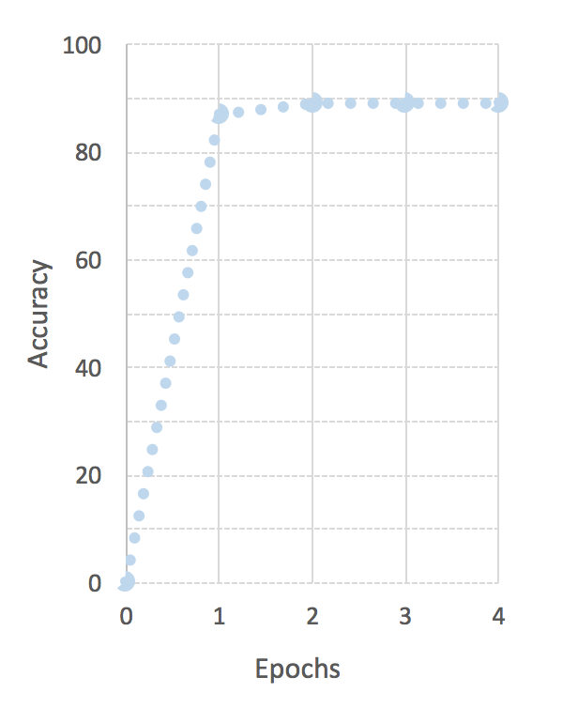
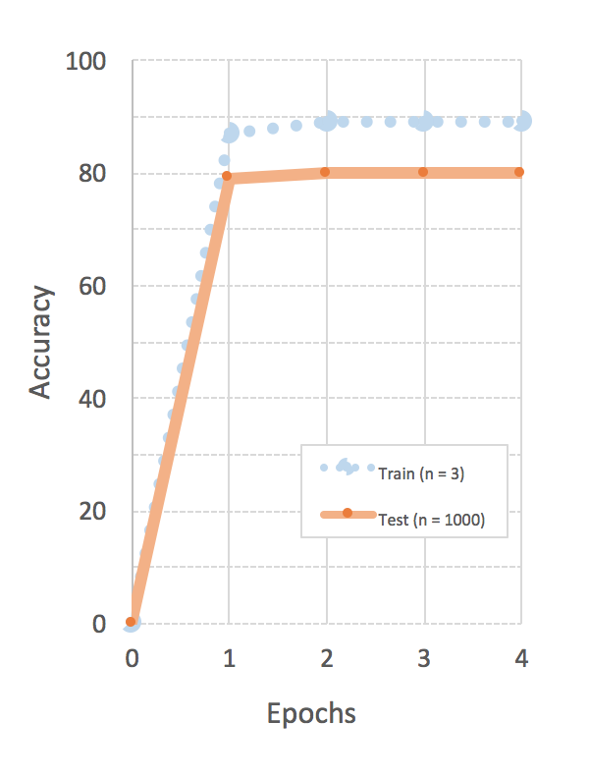

Slide 18


